Slide 1
Discover the New and Renewed Tower of David Jerusalem Museum
YOUR GATEWAY TO JERUSALEM

Slide 2
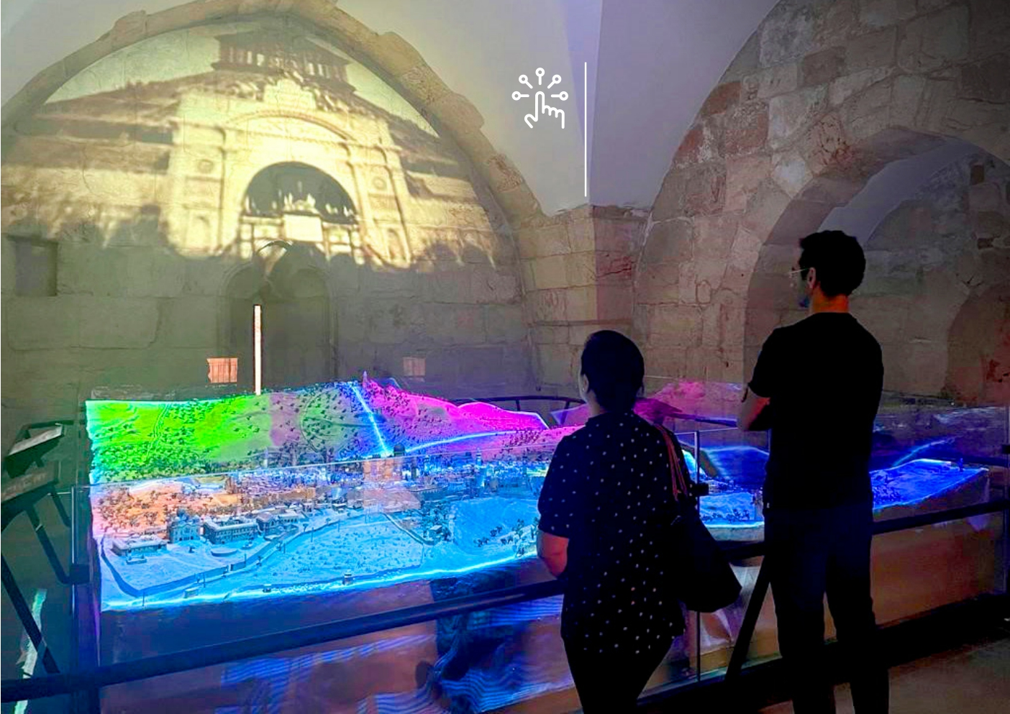
Captivating interactive core exhibition

Slide 3
Captivating interactive core exhibition
7 exhibition galleries celebrating the city's rich historical, cultural, architectural and conceptual diversity
The largest exhibition in the world that explores the complete story
of Jerusalem from its beginning to the present day
Open 7 days a week

Slide 4
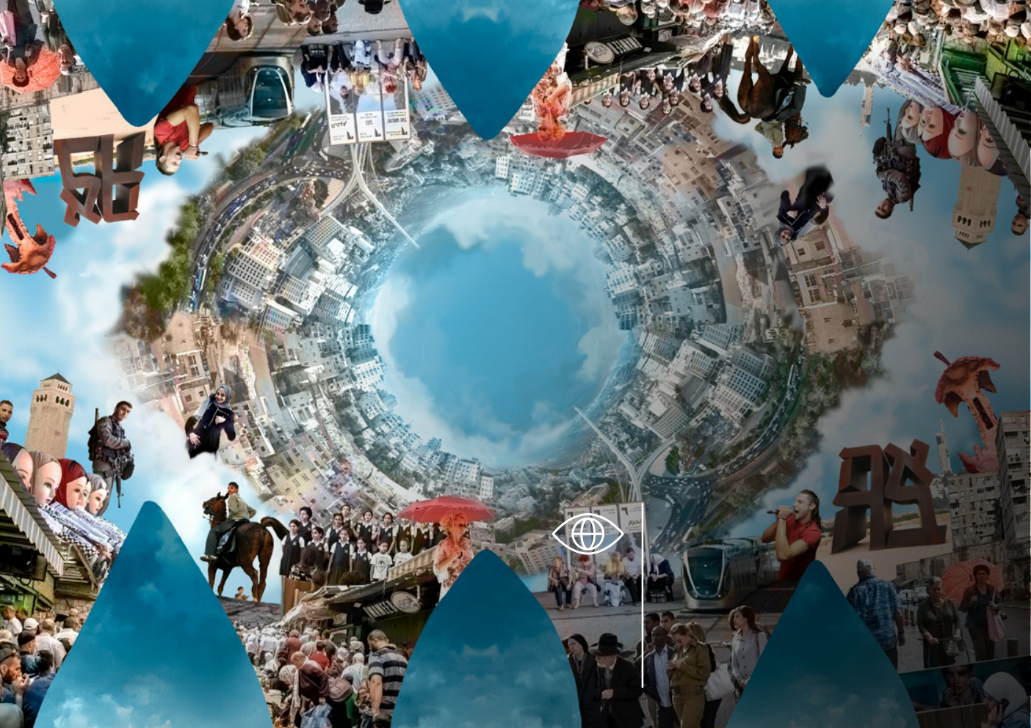
Jerusalem - A Journey to
the Center of the World

Slide 5
A Journey to the Center of the World starting at the Tower of David Jerusalem
Original and rare artifacts from ancient Jerusalem
Animated films
Interactive presentations for the whole family
3D models - ancient and modern Jerusalem
Documentary films Photo collections

Slide 6
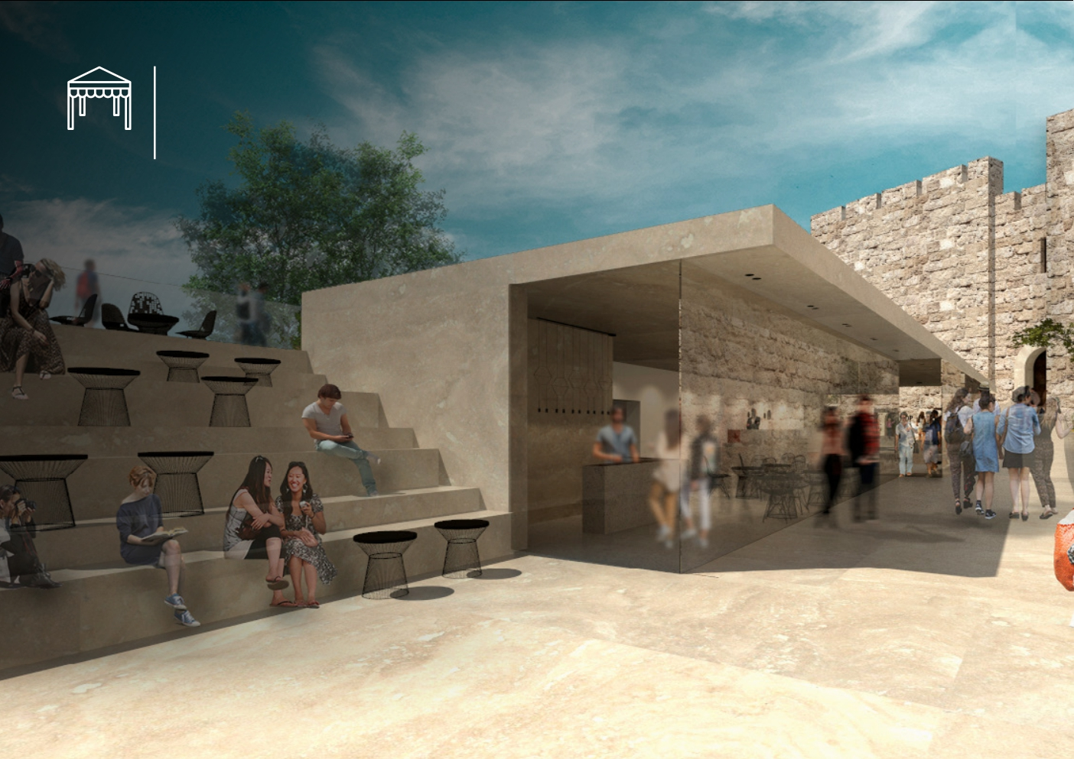
New Entrance Pavilion

Slide 7
New Entrance Pavilion
Convenient and accessible entrance from the West and Mamilla Mall
Gallery for contemporary exhibitions
Coffee Shop
Public Conveniences Shaded seating area

Slide 8
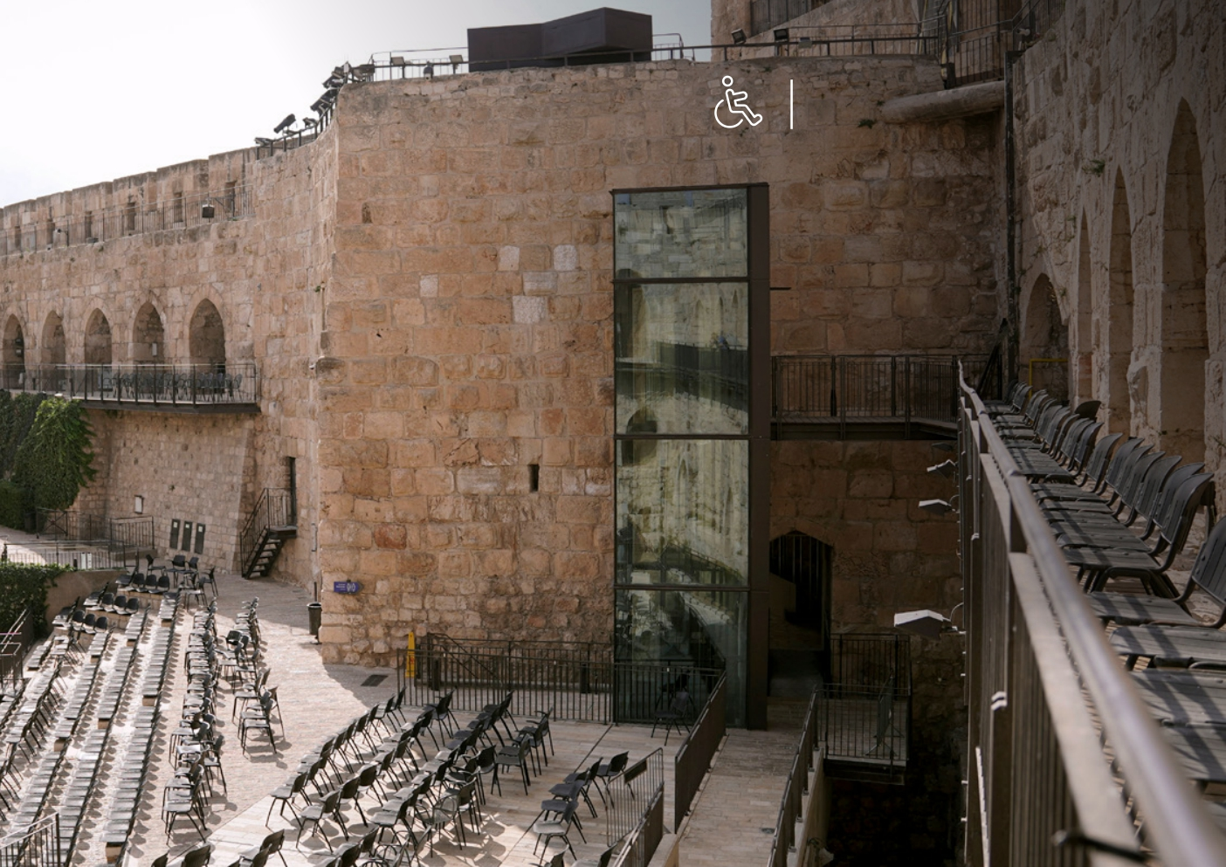
Accessibility

Slide 9
Accessibility
For the first in 3,000 years, the ancient citadel will be accessible to
visitors. Now everyone can visit the Tower of David Jerusalem Museum!
2 Elevators Ramps
Full accessibility in the exhibitions

Slide 10
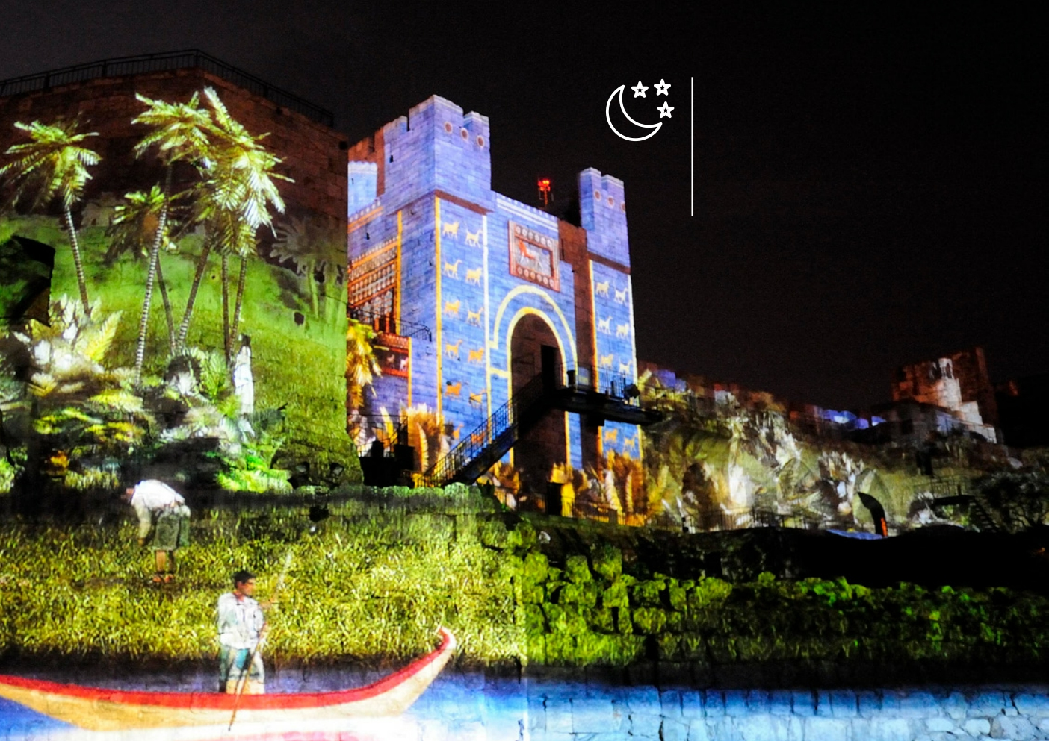
Enchanting Night Experiences

Slide 11
Enchanting Night Experiences
Screened throughout the year, 5 days a week
A 45 minutes show, adapted to tight schedules
Upgrade to a VIP experience that includes:
• Escort from the moment
of entry
• Skip-the-line tickets
• Reserved seats
• A monogrammed blanket
as a souvenir
• A glass of Israeli wine

Slide 12
Herod‘s Palace (The Kishle)

Slide 13
Herod‘s Palace (The Kishle)
The palace built by King Herod the Great that many believe was the Praetorium
An opportunity to explore biblical geography and archeology and the meaning of heavenly and earthly Jerusalem
Included in entrance fee Open 7 days a week

Slide 14
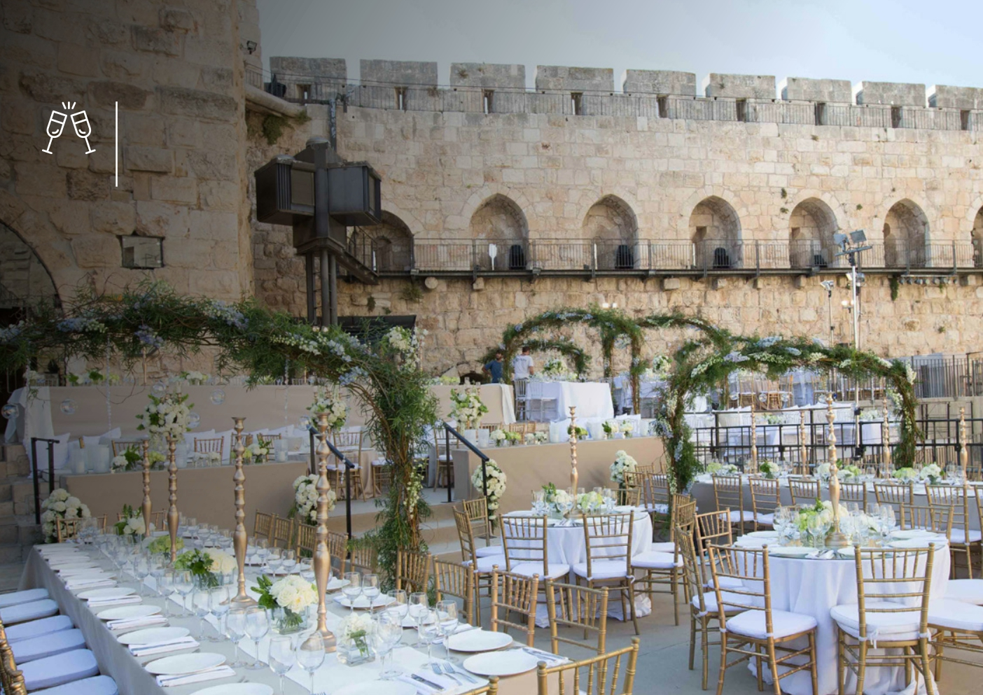
Tailor made private events

Slide 15
Tailor made private events
The perfect location between the Old City and the New City
A beautiful garden with archaeological remains from thousands of years of Jerusalem's history
Different spaces for holding
all types of events - from
2 people to 720 people, especially suitable for family occasions, corporate events, gala evenings, conferences and artistic performances
Guided tours and Night Show viewing can be incorporated in all events

Slide 16
We love challenges and always say YES
Naftali Steg | Managing Director
+972 3 522 4142 | +972 545 552
naftali@naftalitours.com

